Slide 1
Spectral Clustering Part 1: The Graph Laplacian
Ng Yen Kaow

Slide 2
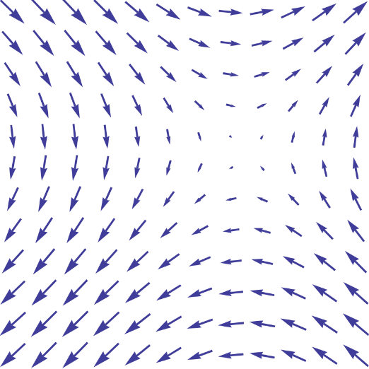

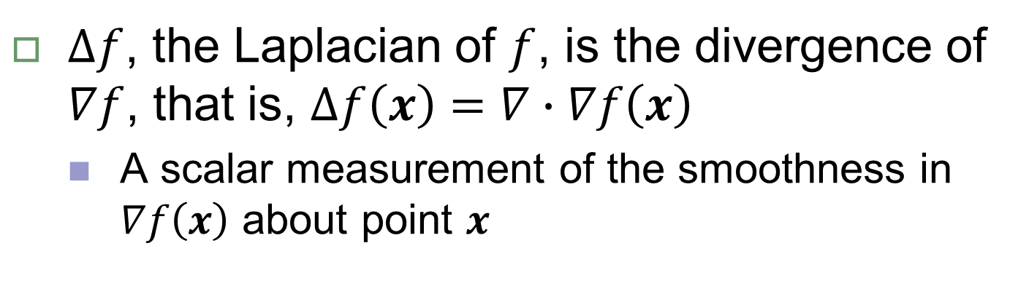


Laplacian of a function
Given a multivariate function $f:ℝ^{n}→ℝ$
$∇f(x)$, the gradient at $f(x)$, is a vector pointing at the steepest ascent of $f(x)$
Vector field $∇f$
$∆f$, the Laplacian of $f$, is the divergence of $∇f$, that is, $∆f\left(x\right)=∇∙∇f\left(x\right)$
A scalar measurement of the smoothness in $∇f\left(x\right)$ about point $x$

Slide 3
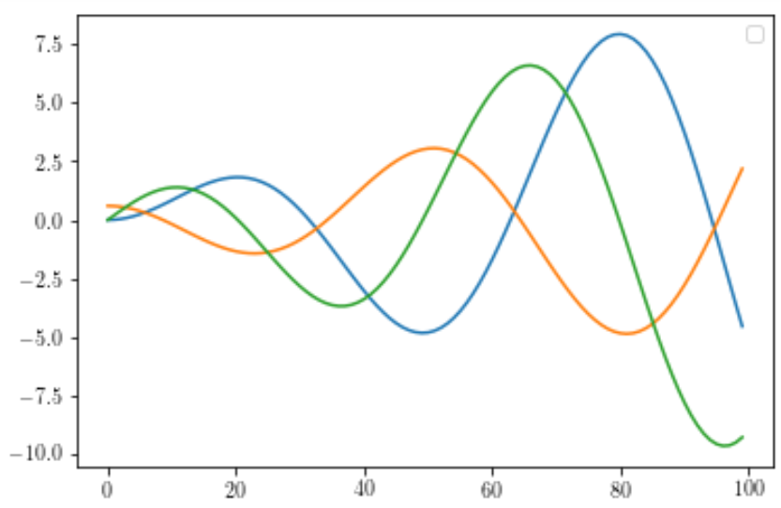



Laplacian of a function
1-D example
$$∇f(x)$$
$$∇∙∇f\left(x\right)$$
$$f\left(x\right)=x\sin{x}$$
smooth decline
no divergence
smooth incline
no divergence
smooth decline
no divergence
not smooth
not smooth

Slide 4









Incidence matrix
Given a function $f:V→ℝ$ on the undirected graph $G=\left\{\left\{A, B, C, D\right\},\left\{e_{1},e_{2},e_{3},e_{4}\right\}\right\}$
$$f\left(A\right)$$
$$f\left(C\right)$$
A
$$e_{2}$$
C
$$e_{4}$$
$$f\left(D\right)$$
$$e_{1}$$
$$e_{3}$$
D
$$f\left(B\right)$$
B

Slide 5
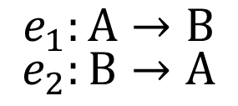
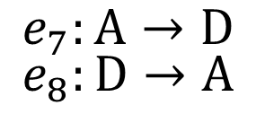

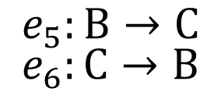
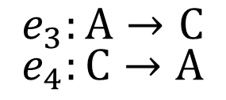
Incidence matrix
Given a function $f:V→ℝ$ on the undirected
$$G=\left\{\left\{A, B, C, D\right\},\left\{e_{1},e_{2},e_{3},e_{4},e_{5},e_{6},e_{7},e_{8}\right\}\right\}$$
$$f\left(A\right)$$
$$f\left(C\right)$$
$$e_{3}:A→C$$
$$e_{4}:C→A$$
A
C
$$e_{7}:A→D$$
$$e_{8}:D→A$$
$$e_{1}:A→B$$
$$e_{2}:B→A$$
$$f\left(D\right)$$
$$e_{5}:B→C$$
$$e_{6}:C→B$$
D
$$f\left(B\right)$$
B

Slide 6
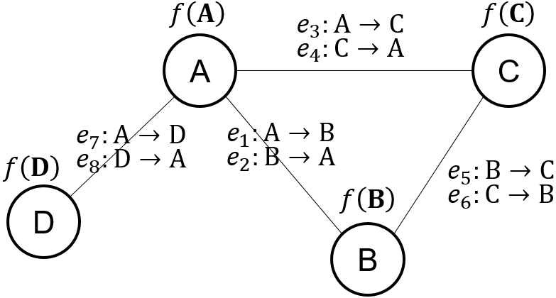
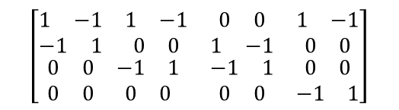


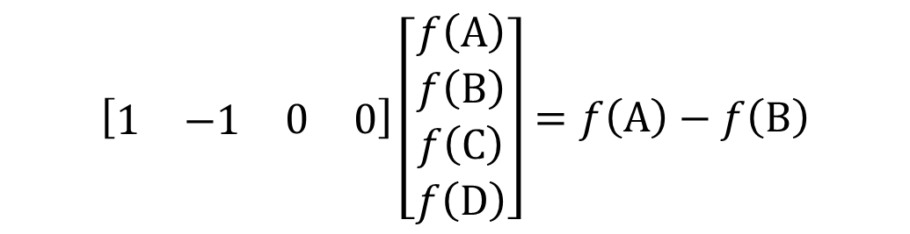
Incidence matrix
(Oriented) incidence matrix
Every column in the incidence matrix describes an edge
$$\begin{matrix}\begin{matrix}\begin{matrix}e_{1} & e_{2}\end{matrix} & \begin{matrix}e_{3} & e_{4}\end{matrix}\end{matrix} & \begin{matrix}\begin{matrix}e_{5} & e_{6}\end{matrix} & \begin{matrix}e_{7} & e_{8}\end{matrix}\end{matrix}\end{matrix}$$
$$\begin{matrix}\begin{matrix}A \\ B\end{matrix} \\ \begin{matrix}C \\ D\end{matrix}\end{matrix}$$
$$\left[\begin{matrix}\begin{matrix}\begin{matrix}1 & −1\end{matrix} & \begin{matrix}1 & −1\end{matrix} \\ \begin{matrix}−1 & 1\end{matrix} & \begin{matrix}0 & 0\end{matrix}\end{matrix} & \begin{matrix}\begin{matrix}0 & 0\end{matrix} & \begin{matrix}1 & −1\end{matrix} \\ \begin{matrix}1 & −1\end{matrix} & \begin{matrix}0 & 0\end{matrix}\end{matrix} \\ \begin{matrix}\begin{matrix}0 & 0\end{matrix} & \begin{matrix}−1 & 1\end{matrix} \\ \begin{matrix}0 & 0\end{matrix} & \begin{matrix}0 & 0\end{matrix}\end{matrix} & \begin{matrix}\begin{matrix}−1 & 1\end{matrix} & \begin{matrix}0 & 0\end{matrix} \\ \begin{matrix}0 & 0\end{matrix} & \begin{matrix}−1 & 1\end{matrix}\end{matrix}\end{matrix}\right]$$
$$\left[\begin{matrix}\begin{matrix}1 & −1\end{matrix} & \begin{matrix}0 & 0\end{matrix}\end{matrix}\right]\left[\begin{matrix}\begin{matrix}f\left(A\right) \\ f\left(B\right)\end{matrix} \\ \begin{matrix}f\left(C\right) \\ f\left(D\right)\end{matrix}\end{matrix}\right]=f\left(A\right)−f\left(B\right)$$

Slide 7
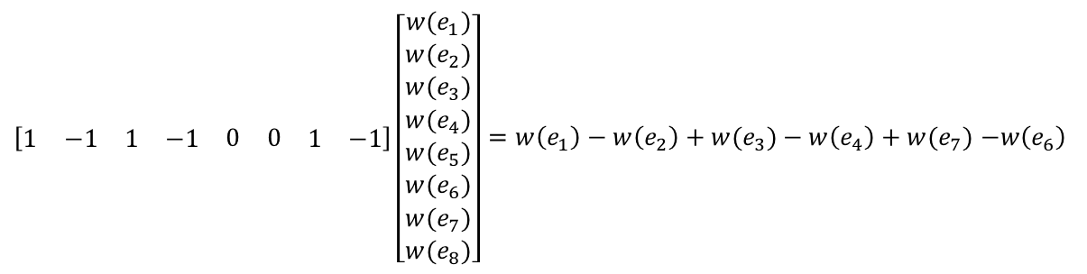

Incidence matrix
(Oriented) incidence matrix
Every row in the incidence matrix describes a vertex
$$\begin{matrix}\begin{matrix}\begin{matrix}e_{1} & e_{2}\end{matrix} & \begin{matrix}e_{3} & e_{4}\end{matrix}\end{matrix} & \begin{matrix}\begin{matrix}e_{5} & e_{6}\end{matrix} & \begin{matrix}e_{7} & e_{8}\end{matrix}\end{matrix}\end{matrix}$$
$$\begin{matrix}\begin{matrix}A \\ B\end{matrix} \\ \begin{matrix}C \\ D\end{matrix}\end{matrix}$$
$$\left[\begin{matrix}\begin{matrix}\begin{matrix}1 & −1\end{matrix} & \begin{matrix}1 & −1\end{matrix} \\ \begin{matrix}−1 & 1\end{matrix} & \begin{matrix}0 & 0\end{matrix}\end{matrix} & \begin{matrix}\begin{matrix}0 & 0\end{matrix} & \begin{matrix}1 & −1\end{matrix} \\ \begin{matrix}1 & −1\end{matrix} & \begin{matrix}0 & 0\end{matrix}\end{matrix} \\ \begin{matrix}\begin{matrix}0 & 0\end{matrix} & \begin{matrix}−1 & 1\end{matrix} \\ \begin{matrix}0 & 0\end{matrix} & \begin{matrix}0 & 0\end{matrix}\end{matrix} & \begin{matrix}\begin{matrix}−1 & 1\end{matrix} & \begin{matrix}0 & 0\end{matrix} \\ \begin{matrix}0 & 0\end{matrix} & \begin{matrix}−1 & 1\end{matrix}\end{matrix}\end{matrix}\right]$$
$\left[\begin{matrix}\begin{matrix}\begin{matrix}1 & −1\end{matrix} & \begin{matrix}1 & −1\end{matrix}\end{matrix} & \begin{matrix}\begin{matrix}0 & 0\end{matrix} & \begin{matrix}1 & −1\end{matrix}\end{matrix}\end{matrix}\right]\left[\begin{matrix}\begin{matrix}\begin{matrix}w(e_{1}) \\ w(e_{2})\end{matrix} \\ \begin{matrix}w(e_{3}) \\ w(e_{4})\end{matrix}\end{matrix} \\ \begin{matrix}\begin{matrix}w(e_{5}) \\ w(e_{6})\end{matrix} \\ \begin{matrix}w(e_{7}) \\ w(e_{8})\end{matrix}\end{matrix}\end{matrix}\right]=w\left(e_{1}\right)−w\left(e_{2}\right)+w(e_{3})−w\left(e_{4}\right)+w(e_{7})$ $−w\left(e_{6}\right)$
$w\left(e\right)$ is the weight of edge $e$

Slide 8
Incidence matrix
Incidence matrix encodes the graph structure
What constitutes an incidence matrix is not strictly defined
Open to re-definition
Results may differ
Let’s look at some examples

Slide 9
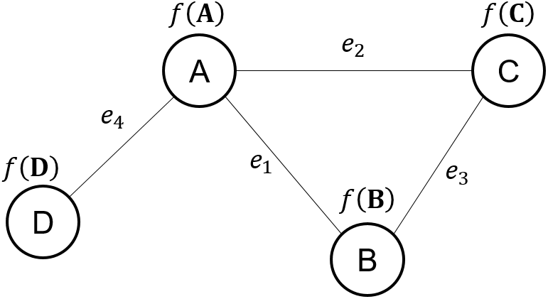
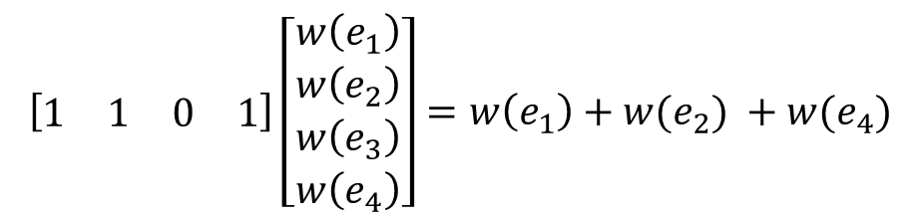

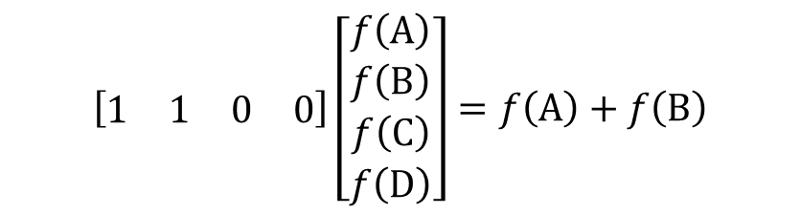


(Unoriented) incidence matrix
https://en.wikipedia.org/wiki/Incidence_matrix
$$\begin{matrix}\begin{matrix}e_{1} & e_{2}\end{matrix} & \begin{matrix}e_{3} & e_{4}\end{matrix}\end{matrix}$$
$$\left[\begin{matrix}\begin{matrix}\begin{matrix}1 & 1\end{matrix} & \begin{matrix}0 & 1\end{matrix} \\ \begin{matrix}1 & 0\end{matrix} & \begin{matrix}1 & 0\end{matrix}\end{matrix} \\ \begin{matrix}\begin{matrix}0 & 1\end{matrix} & \begin{matrix}1 & 0\end{matrix} \\ \begin{matrix}0 & 0\end{matrix} & \begin{matrix}0 & 1\end{matrix}\end{matrix}\end{matrix}\right]$$
$$\left[\begin{matrix}\begin{matrix}1 & 1\end{matrix} & \begin{matrix}0 & 0\end{matrix}\end{matrix}\right]\left[\begin{matrix}\begin{matrix}f\left(A\right) \\ f\left(B\right)\end{matrix} \\ \begin{matrix}f\left(C\right) \\ f\left(D\right)\end{matrix}\end{matrix}\right]=f\left(A\right)+f\left(B\right)$$
$$\begin{matrix}\begin{matrix}A \\ B\end{matrix} \\ \begin{matrix}C \\ D\end{matrix}\end{matrix}$$
$$\left[\begin{matrix}\begin{matrix}1 & 1\end{matrix} & \begin{matrix}0 & 1\end{matrix}\end{matrix}\right]\left[\begin{matrix}\begin{matrix}w\left(e_{1}\right) \\ w\left(e_{2}\right)\end{matrix} \\ \begin{matrix}w\left(e_{3}\right) \\ w\left(e_{4}\right)\end{matrix}\end{matrix}\right]=w\left(e_{1}\right)+w(e_{2}) +w(e_{4})$$

Slide 10
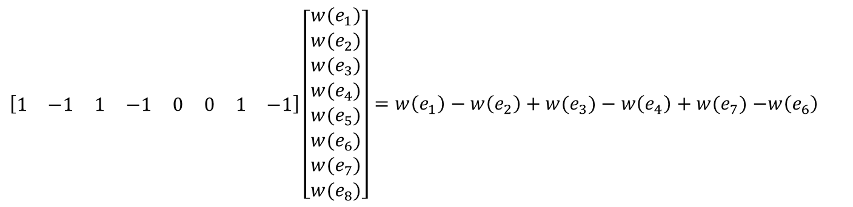
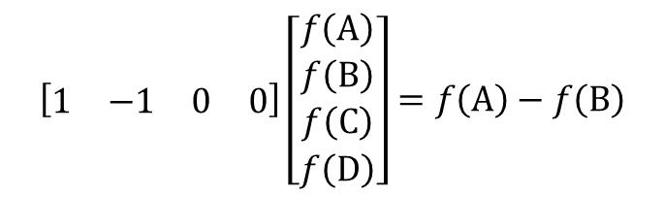
(Oriented) incidence matrix
As shown earlier, this is
https://en.wikipedia.org/wiki/Incidence_matrix
$$\begin{matrix}\begin{matrix}\begin{matrix}e_{1} & e_{2}\end{matrix} & \begin{matrix}e_{3} & e_{4}\end{matrix}\end{matrix} & \begin{matrix}\begin{matrix}e_{5} & e_{6}\end{matrix} & \begin{matrix}e_{7} & e_{8}\end{matrix}\end{matrix}\end{matrix}$$
$$\begin{matrix}\begin{matrix}A \\ B\end{matrix} \\ \begin{matrix}C \\ D\end{matrix}\end{matrix}$$
$$\left[\begin{matrix}\begin{matrix}\begin{matrix}1 & −1\end{matrix} & \begin{matrix}1 & −1\end{matrix} \\ \begin{matrix}−1 & 1\end{matrix} & \begin{matrix}0 & 0\end{matrix}\end{matrix} & \begin{matrix}\begin{matrix}0 & 0\end{matrix} & \begin{matrix}1 & −1\end{matrix} \\ \begin{matrix}1 & −1\end{matrix} & \begin{matrix}0 & 0\end{matrix}\end{matrix} \\ \begin{matrix}\begin{matrix}0 & 0\end{matrix} & \begin{matrix}−1 & 1\end{matrix} \\ \begin{matrix}0 & 0\end{matrix} & \begin{matrix}0 & 0\end{matrix}\end{matrix} & \begin{matrix}\begin{matrix}−1 & 1\end{matrix} & \begin{matrix}0 & 0\end{matrix} \\ \begin{matrix}0 & 0\end{matrix} & \begin{matrix}−1 & 1\end{matrix}\end{matrix}\end{matrix}\right]$$
$$\left[\begin{matrix}\begin{matrix}1 & −1\end{matrix} & \begin{matrix}0 & 0\end{matrix}\end{matrix}\right]\left[\begin{matrix}\begin{matrix}f\left(A\right) \\ f\left(B\right)\end{matrix} \\ \begin{matrix}f\left(C\right) \\ f\left(D\right)\end{matrix}\end{matrix}\right]=f\left(A\right)−f\left(B\right)$$
$\left[\begin{matrix}\begin{matrix}\begin{matrix}1 & −1\end{matrix} & \begin{matrix}1 & −1\end{matrix}\end{matrix} & \begin{matrix}\begin{matrix}0 & 0\end{matrix} & \begin{matrix}1 & −1\end{matrix}\end{matrix}\end{matrix}\right]\left[\begin{matrix}\begin{matrix}\begin{matrix}w(e_{1}) \\ w(e_{2})\end{matrix} \\ \begin{matrix}w(e_{3}) \\ w(e_{4})\end{matrix}\end{matrix} \\ \begin{matrix}\begin{matrix}w(e_{5}) \\ w(e_{6})\end{matrix} \\ \begin{matrix}w(e_{7}) \\ w(e_{8})\end{matrix}\end{matrix}\end{matrix}\right]=w\left(e_{1}\right)−w\left(e_{2}\right)+w(e_{3})−w\left(e_{4}\right)+w(e_{7})$ $−w\left(e_{6}\right)$

Slide 11
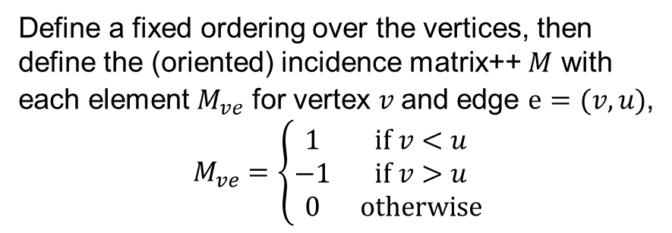
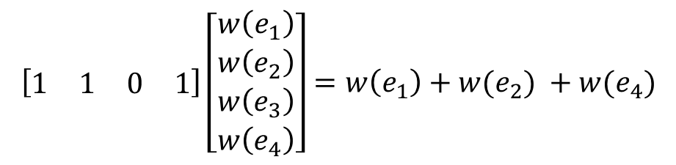

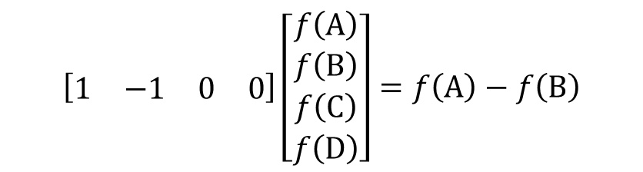



(Oriented) incidence matrix++
Ordering $A<B<C<D$
https://en.wikipedia.org/wiki/Laplacian_matrix#Incidence_matrix
Define a fixed ordering over the vertices, then define the (oriented) incidence matrix++ $M$ with each element $M_{ve}$ for vertex $v$and edge $e=(v, u)$,
$$M_{ve}=\left\{\begin{matrix}1 & if v<u \\ −1 & if v>u \\ 0 & otherwise\end{matrix}\right.$$
$$\begin{matrix}\begin{matrix}e_{1} & e_{2}\end{matrix} & \begin{matrix}e_{3} & e_{4}\end{matrix}\end{matrix}$$
$$\left[\begin{matrix}\begin{matrix}\begin{matrix}1 & 1\end{matrix} & \begin{matrix}0 & 1\end{matrix} \\ \begin{matrix}−1 & 0\end{matrix} & \begin{matrix}1 & 0\end{matrix}\end{matrix} \\ \begin{matrix}\begin{matrix}0 & −1\end{matrix} & \begin{matrix}−1 & 0\end{matrix} \\ \begin{matrix}0 & 0\end{matrix} & \begin{matrix}0 & −1\end{matrix}\end{matrix}\end{matrix}\right]$$
$$\begin{matrix}\begin{matrix}A \\ B\end{matrix} \\ \begin{matrix}C \\ D\end{matrix}\end{matrix}$$
$$\left[\begin{matrix}\begin{matrix}1 & −1\end{matrix} & \begin{matrix}0 & 0\end{matrix}\end{matrix}\right]\left[\begin{matrix}\begin{matrix}f\left(A\right) \\ f\left(B\right)\end{matrix} \\ \begin{matrix}f\left(C\right) \\ f\left(D\right)\end{matrix}\end{matrix}\right]=f\left(A\right)−f\left(B\right)$$
$$\left[\begin{matrix}\begin{matrix}1 & 1\end{matrix} & \begin{matrix}0 & 1\end{matrix}\end{matrix}\right]\left[\begin{matrix}\begin{matrix}w\left(e_{1}\right) \\ w\left(e_{2}\right)\end{matrix} \\ \begin{matrix}w\left(e_{3}\right) \\ w\left(e_{4}\right)\end{matrix}\end{matrix}\right]=w\left(e_{1}\right)+w(e_{2}) +w(e_{4})$$

Slide 12
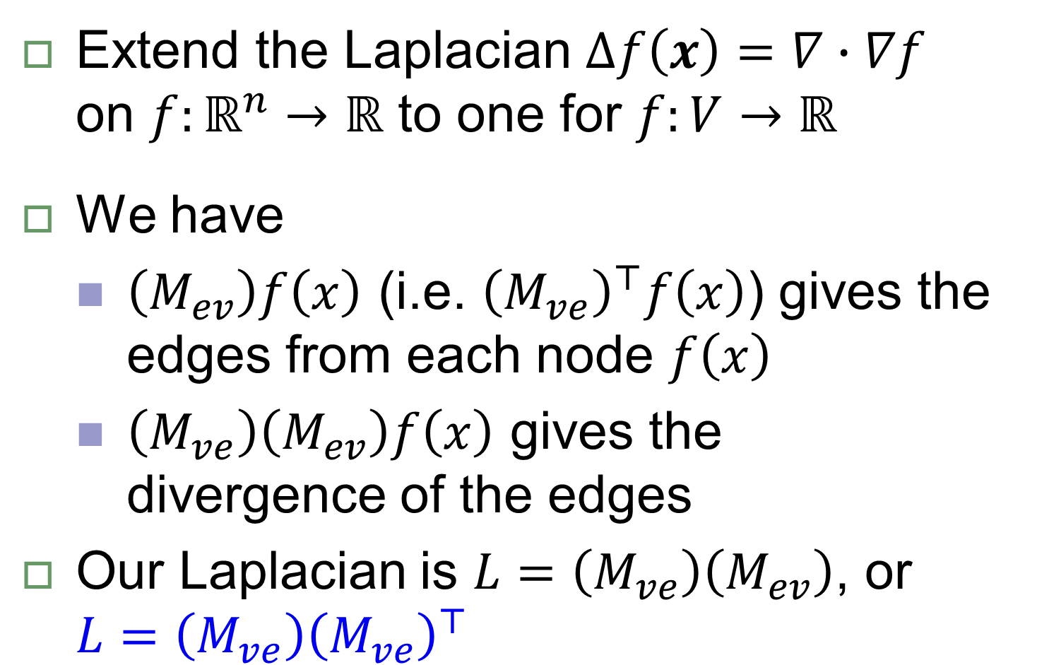
Graph Laplacian
Extend the Laplacian $∆f\left(x\right)=∇∙∇f$ on $f:ℝ^{n}→ℝ$ to one for $f:V→ℝ$
We have
$\left(M_{ev}\right)f\left(x\right)$ (i.e. ${\left(M_{ve}\right)}^{⊤}f\left(x\right)$) gives the edges from each node $f\left(x\right)$
$\left(M_{ve}\right)\left(M_{ev}\right)f\left(x\right)$ gives the divergence of the edges
Our Laplacian is $L=\left(M_{ve}\right)\left(M_{ev}\right)$, or ${L=\left(M_{ve}\right)\left(M_{ve}\right)}^{⊤}$

Slide 13
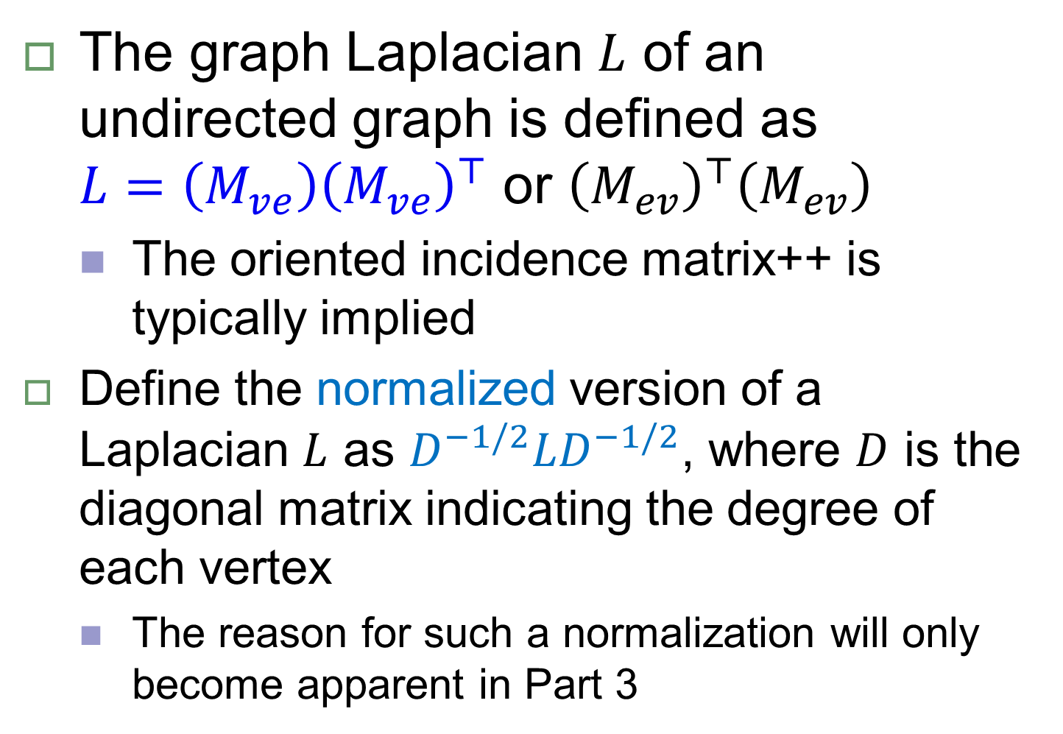
Normalized Graph Laplacian
The graph Laplacian $L$ of an undirected graph is defined as ${L=\left(M_{ve}\right)\left(M_{ve}\right)}^{⊤}$ or ${\left(M_{ev}\right)}^{⊤}\left(M_{ev}\right)$
The oriented incidence matrix++ is typically implied
Define the normalized version of a Laplacian $L$ as $D^{−1/2}LD^{−1/2}$, where $D$ is the diagonal matrix indicating the degree of each vertex
The reason for such a normalization will only become apparent in Part 3

Slide 14




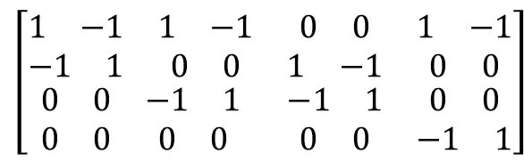
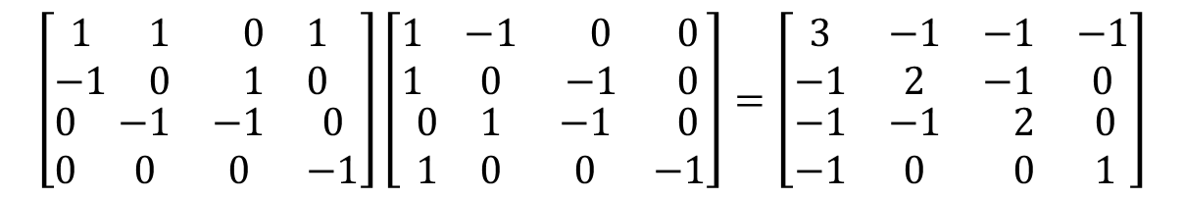
Laplacian $L$for earlier matrices
Unoriented incidence matrix ($L=D+A$)
Oriented incidence matrix ($L=D−2A$)
Oriented incidence matrix++ ($L=D−A$)
$$\left[\begin{matrix}\begin{matrix}1 & 1 \\ 1 & 0\end{matrix} & \begin{matrix}0 & 1 \\ 1 & 0\end{matrix} \\ \begin{matrix}0 & 1 \\ 0 & 0\end{matrix} & \begin{matrix}1 & 0 \\ 0 & 1\end{matrix}\end{matrix}\right]\left[\begin{matrix}\begin{matrix}1 & 1 \\ 1 & 0\end{matrix} & \begin{matrix}0 & 0 \\ 1 & 0\end{matrix} \\ \begin{matrix}0 & 1 \\ 1 & 0\end{matrix} & \begin{matrix}1 & 0 \\ 0 & 1\end{matrix}\end{matrix}\right]=\left[\begin{matrix}\begin{matrix}3 & 1 \\ 1 & 2\end{matrix} & \begin{matrix}1 & 1 \\ 1 & 0\end{matrix} \\ \begin{matrix}1 & 1 \\ 1 & 0\end{matrix} & \begin{matrix}2 & 0 \\ 0 & 1\end{matrix}\end{matrix}\right]$$
Adjacency matrix
$$\left[\begin{matrix}\begin{matrix}\begin{matrix}1 \\ −1\end{matrix} & \begin{matrix}−1 \\ 1\end{matrix} \\ \begin{matrix}1 \\ −1\end{matrix} & \begin{matrix}0 \\ 0\end{matrix}\end{matrix} & \begin{matrix}\begin{matrix}0 \\ 0\end{matrix} & \begin{matrix}0 \\ 0\end{matrix} \\ \begin{matrix}−1 \\ 1\end{matrix} & \begin{matrix}0 \\ 0\end{matrix}\end{matrix} \\ \begin{matrix}\begin{matrix}0 \\ 0\end{matrix} & \begin{matrix}1 \\ −1\end{matrix} \\ \begin{matrix}1 \\ −1\end{matrix} & \begin{matrix}0 \\ 0\end{matrix}\end{matrix} & \begin{matrix}\begin{matrix}−1 \\ 1\end{matrix} & \begin{matrix}0 \\ 0\end{matrix} \\ \begin{matrix}0 \\ 0\end{matrix} & \begin{matrix}−1 \\ 1\end{matrix}\end{matrix}\end{matrix}\right]=\left[\begin{matrix}\begin{matrix}6 & −2 \\ −2 & 4\end{matrix} & \begin{matrix}−2 & −2 \\ −2 & 0\end{matrix} \\ \begin{matrix}−2 & −2 \\ −2 & 0\end{matrix} & \begin{matrix}4 & 0 \\ 0 & 2\end{matrix}\end{matrix}\right]$$
$$\left[\begin{matrix}\begin{matrix}\begin{matrix}1 & −1\end{matrix} & \begin{matrix}1 & −1\end{matrix} \\ \begin{matrix}−1 & 1\end{matrix} & \begin{matrix}0 & 0\end{matrix}\end{matrix} & \begin{matrix}\begin{matrix}0 & 0\end{matrix} & \begin{matrix}1 & −1\end{matrix} \\ \begin{matrix}1 & −1\end{matrix} & \begin{matrix}0 & 0\end{matrix}\end{matrix} \\ \begin{matrix}\begin{matrix}0 & 0\end{matrix} & \begin{matrix}−1 & 1\end{matrix} \\ \begin{matrix}0 & 0\end{matrix} & \begin{matrix}0 & 0\end{matrix}\end{matrix} & \begin{matrix}\begin{matrix}−1 & 1\end{matrix} & \begin{matrix}0 & 0\end{matrix} \\ \begin{matrix}0 & 0\end{matrix} & \begin{matrix}−1 & 1\end{matrix}\end{matrix}\end{matrix}\right]$$
$$\left[\begin{matrix}\begin{matrix}1 & 1 \\ −1 & 0\end{matrix} & \begin{matrix}0 & 1 \\ 1 & 0\end{matrix} \\ \begin{matrix}0 & −1 \\ 0 & 0\end{matrix} & \begin{matrix}−1 & 0 \\ 0 & −1\end{matrix}\end{matrix}\right]\left[\begin{matrix}\begin{matrix}1 & −1 \\ 1 & 0\end{matrix} & \begin{matrix} 0 & 0 \\ −1 & 0\end{matrix} \\ \begin{matrix}0 & 1 \\ 1 & 0\end{matrix} & \begin{matrix}−1 & 0 \\ 0 & −1\end{matrix}\end{matrix}\right]=\left[\begin{matrix}\begin{matrix}3 & −1 \\ −1 & 2\end{matrix} & \begin{matrix}−1 & −1 \\ −1 & 0\end{matrix} \\ \begin{matrix}−1 & −1 \\ −1 & 0\end{matrix} & \begin{matrix} 2 & 0 \\ 0 & 1\end{matrix}\end{matrix}\right]$$

Slide 15
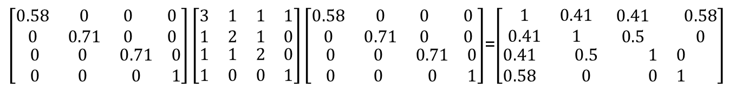
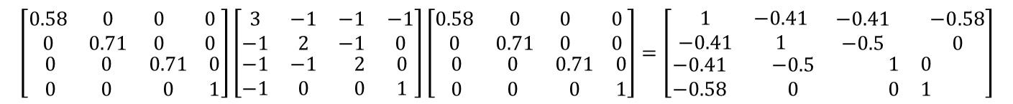

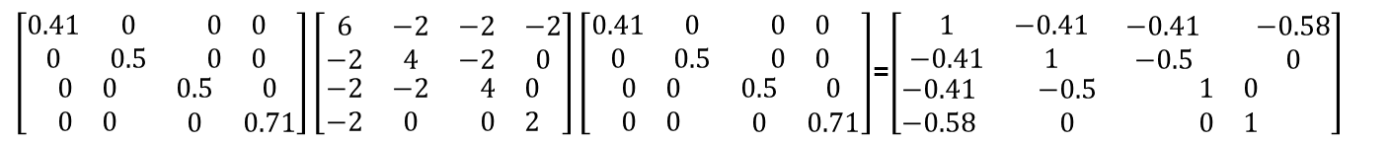
$D^{−1/2}LD^{−1/2}$ for earlier matrices
Unoriented incidence matrix
Oriented incidence matrix
Oriented incidence matrix++
Note that normalization unified the oriented incidence matrices
$\left[\begin{matrix}\begin{matrix}0.58 & 0 \\ 0 & 0.71\end{matrix} & \begin{matrix}0 & 0 \\ 0 & 0\end{matrix} \\ \begin{matrix}0 & 0 \\ 0 & 0\end{matrix} & \begin{matrix}0.71 & 0 \\ 0 & 1\end{matrix}\end{matrix}\right]\left[\begin{matrix}\begin{matrix}3 & 1 \\ 1 & 2\end{matrix} & \begin{matrix}1 & 1 \\ 1 & 0\end{matrix} \\ \begin{matrix}1 & 1 \\ 1 & 0\end{matrix} & \begin{matrix}2 & 0 \\ 0 & 1\end{matrix}\end{matrix}\right]\left[\begin{matrix}\begin{matrix}0.58 & 0 \\ 0 & 0.71\end{matrix} & \begin{matrix}0 & 0 \\ 0 & 0\end{matrix} \\ \begin{matrix}0 & 0 \\ 0 & 0\end{matrix} & \begin{matrix}0.71 & 0 \\ 0 & 1\end{matrix}\end{matrix}\right]$=$\left[\begin{matrix}\begin{matrix}1 & 0.41 \\ 0.41 & 1\end{matrix} & \begin{matrix}0.41 & 0.58 \\ 0.5 & 0\end{matrix} \\ \begin{matrix}0.41 & 0.5 \\ 0.58 & 0\end{matrix} & \begin{matrix}1 & 0 \\ 0 & 1\end{matrix}\end{matrix}\right]$
$\left[\begin{matrix}\begin{matrix}0.41 & 0 \\ 0 & 0.5\end{matrix} & \begin{matrix}0 & 0 \\ 0 & 0\end{matrix} \\ \begin{matrix}0 & 0 \\ 0 & 0\end{matrix} & \begin{matrix}0.5 & 0 \\ 0 & 0.71\end{matrix}\end{matrix}\right]\left[\begin{matrix}\begin{matrix}6 & −2 \\ −2 & 4\end{matrix} & \begin{matrix}−2 & −2 \\ −2 & 0\end{matrix} \\ \begin{matrix}−2 & −2 \\ −2 & 0\end{matrix} & \begin{matrix}4 & 0 \\ 0 & 2\end{matrix}\end{matrix}\right]\left[\begin{matrix}\begin{matrix}0.41 & 0 \\ 0 & 0.5\end{matrix} & \begin{matrix}0 & 0 \\ 0 & 0\end{matrix} \\ \begin{matrix}0 & 0 \\ 0 & 0\end{matrix} & \begin{matrix}0.5 & 0 \\ 0 & 0.71\end{matrix}\end{matrix}\right]$=$\left[\begin{matrix}\begin{matrix}1 & −0.41 \\ −0.41 & 1\end{matrix} & \begin{matrix}−0.41 & −0.58 \\ −0.5 & 0\end{matrix} \\ \begin{matrix}−0.41 & −0.5 \\ −0.58 & 0\end{matrix} & \begin{matrix}1 & 0 \\ 0 & 1\end{matrix}\end{matrix}\right]$
$$\left[\begin{matrix}\begin{matrix}0.58 & 0 \\ 0 & 0.71\end{matrix} & \begin{matrix}0 & 0 \\ 0 & 0\end{matrix} \\ \begin{matrix}0 & 0 \\ 0 & 0\end{matrix} & \begin{matrix}0.71 & 0 \\ 0 & 1\end{matrix}\end{matrix}\right]\left[\begin{matrix}\begin{matrix}3 & −1 \\ −1 & 2\end{matrix} & \begin{matrix}−1 & −1 \\ −1 & 0\end{matrix} \\ \begin{matrix}−1 & −1 \\ −1 & 0\end{matrix} & \begin{matrix} 2 & 0 \\ 0 & 1\end{matrix}\end{matrix}\right]\left[\begin{matrix}\begin{matrix}0.58 & 0 \\ 0 & 0.71\end{matrix} & \begin{matrix}0 & 0 \\ 0 & 0\end{matrix} \\ \begin{matrix}0 & 0 \\ 0 & 0\end{matrix} & \begin{matrix}0.71 & 0 \\ 0 & 1\end{matrix}\end{matrix}\right]=\left[\begin{matrix}\begin{matrix}1 & −0.41 \\ −0.41 & 1\end{matrix} & \begin{matrix}−0.41 & −0.58 \\ −0.5 & 0\end{matrix} \\ \begin{matrix}−0.41 & −0.5 \\ −0.58 & 0\end{matrix} & \begin{matrix}1 & 0 \\ 0 & 1\end{matrix}\end{matrix}\right]$$

Slide 16


Significance of the graph Laplacian
Each row in $L$ describes the dependency of a vertex with respect to the others
Let the adjacency matrix $A=\left(a_{ij}\right)$, then
$$x^{⊤}Lx=\frac{1}{2}\sum_{i,j=1}^{m}{{a_{ij}\left(x_{i}−x_{j}\right)}^{2}}$$
$$x^{⊤}Lx=x^{⊤}Dx−x^{⊤}Ax=\sum_{i=1}^{m}{d_{i}x_{i}^{2}}−\sum_{i,j=1}^{m}{a_{ij}x_{i}x_{j}}$$
$$=\frac{1}{2}\left(\sum_{i=1}^{m}{d_{i}x_{i}^{2}}−2\sum_{i,j=1}^{m}{a_{ij}x_{i}x_{j}}+\sum_{i=1}^{m}{d_{i}x_{i}^{2}}\right)$$
$$=\frac{1}{2}\sum_{i,j=1}^{m}{{a_{ij}\left(x_{i}−x_{j}\right)}^{2}}$$

Slide 17
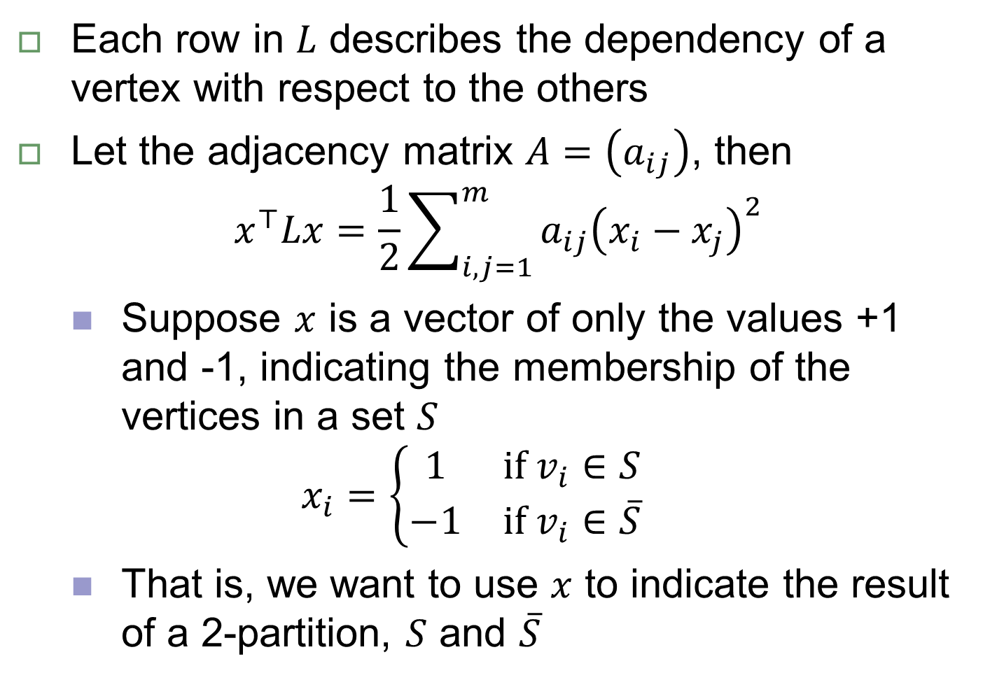
Significance of the graph Laplacian
Each row in $L$ describes the dependency of a vertex with respect to the others
Let the adjacency matrix $A=\left(a_{ij}\right)$, then
$$x^{⊤}Lx=\frac{1}{2}\sum_{i,j=1}^{m}{{a_{ij}\left(x_{i}−x_{j}\right)}^{2}}$$
Suppose $x$ is a vector of only the values +1 and -1, indicating the membership of the vertices in a set $S$
$$x_{i}=\left\{\begin{matrix}1 & if v_{i}∈S \\ −1 & if v_{i}∈\overline{S}\end{matrix}\right.$$
That is, we want to use $x$ to indicate the result of a 2-partition, $S$ and $\overline{S}$

Slide 18
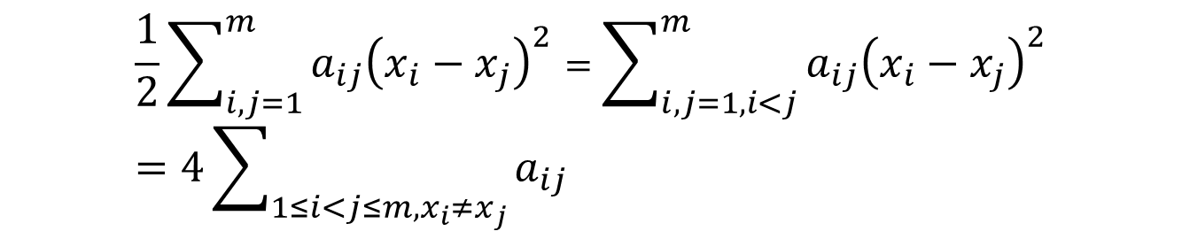
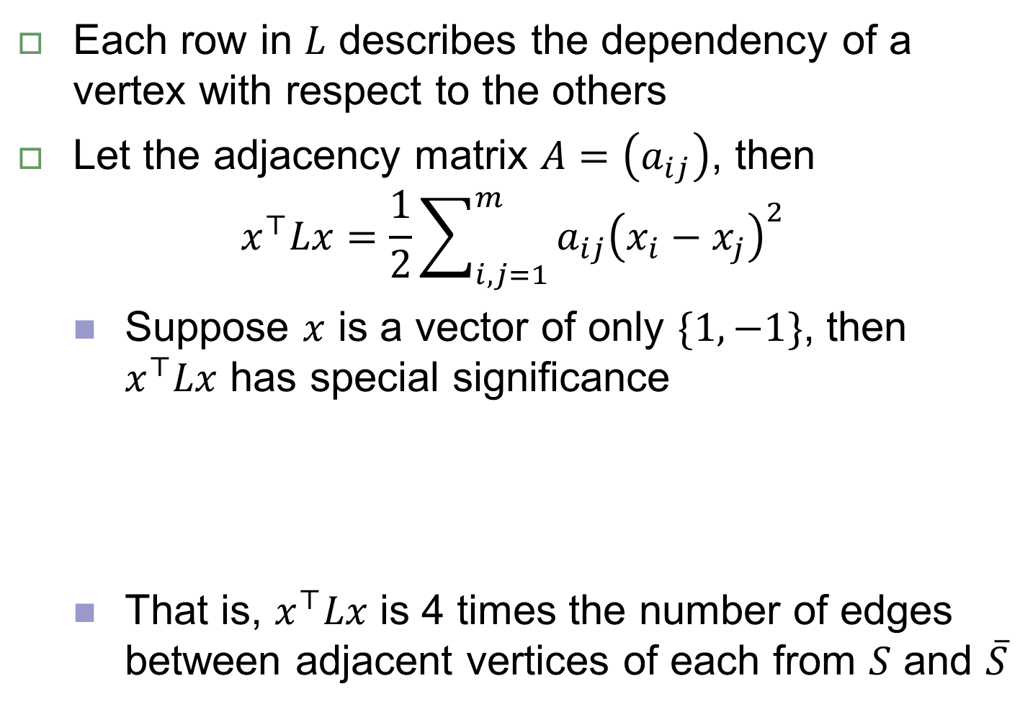
Significance of the graph Laplacian
Each row in $L$ describes the dependency of a vertex with respect to the others
Let the adjacency matrix $A=\left(a_{ij}\right)$, then
$$x^{⊤}Lx=\frac{1}{2}\sum_{i,j=1}^{m}{{a_{ij}\left(x_{i}−x_{j}\right)}^{2}}$$
Suppose $x$ is a vector of only $\{1, −1\}$, then $x^{⊤}Lx$ has special significance
That is, $x^{⊤}Lx$ is 4 times the number of edges between adjacent vertices of each from $S$ and $\overline{S}$
$$\frac{1}{2}\sum_{i,j=1}^{m}{{a_{ij}\left(x_{i}−x_{j}\right)}^{2}}=\sum_{i,j=1,i<j}^{m}{{a_{ij}\left(x_{i}−x_{j}\right)}^{2}}=4\sum_{1≤i<j≤m,x_{i}≠x_{j}}{a_{ij}}$$

Slide 19
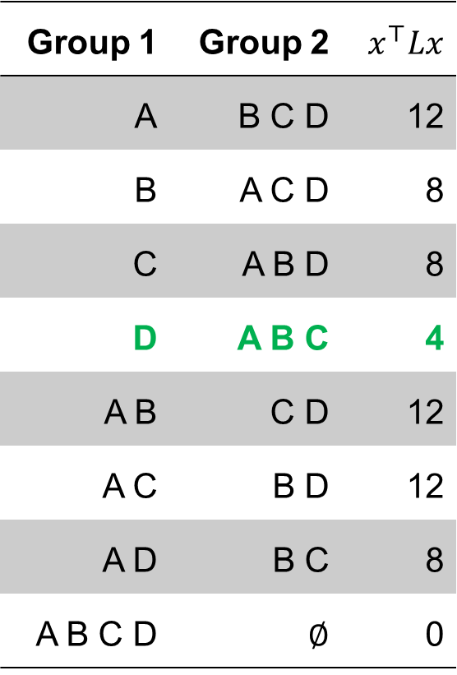
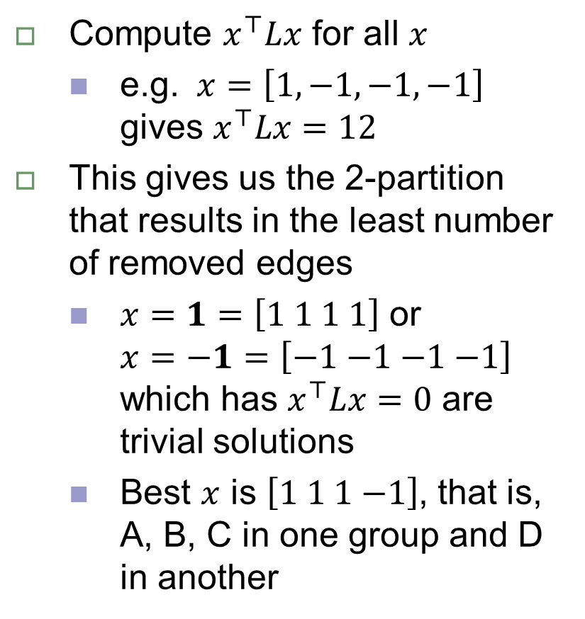
Intuitions of the graph Laplacian
Compute $x^{⊤}Lx$ for all $x$
e.g. $x=\left[1,−1,−1,−1\right]$ gives $x^{⊤}Lx=12$
This gives us the 2-partition that results in the least number of removed edges
$x=1=\left[1 1 1 1\right]$ or $x=\text{−}1=\left[\text{−}1 \text{−}1 \text{−}1 \text{−}1\right]$ which has $x^{⊤}Lx=0$ are trivial solutions
Best $x$ is $\left[1 1 1\text{ −}1\right]$, that is, A, B, C in one group and D in another
Group 1 | Group 2 | $$x^{⊤}Lx$$
A | B C D | 12
B | A C D | 8
C | A B D | 8
D | A B C | 4
A B | C D | 12
A C | B D | 12
A D | B C | 8
A B C D | $$∅$$ | 0
The optimal $x$ can be approximately found

Slide 20
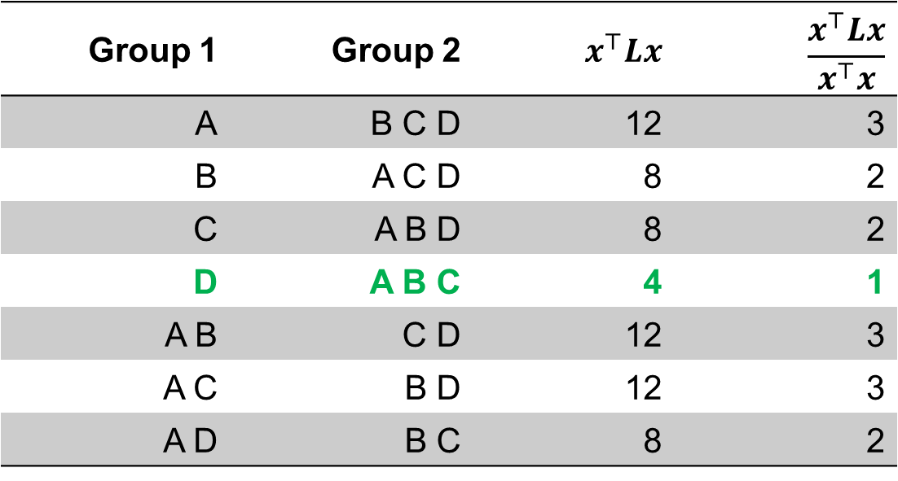

Rayleigh Quotient
Minimize $x^{⊤}Lx$
Consider instead problem of minimizing $\frac{x^{⊤}Lx}{x^{⊤}x}$
$x$ is of only +1 and -1 $⇒$ $x^{⊤}x=\left|x\right|=$ const
Group 1 | Group 2 | $$x^{⊤}Lx$$ | $$\frac{x^{⊤}Lx}{x^{⊤}x}$$
A | B C D | 12 | 3
B | A C D | 8 | 2
C | A B D | 8 | 2
D | A B C | 4 | 1
A B | C D | 12 | 3
A C | B D | 12 | 3
A D | B C | 8 | 2

Slide 21
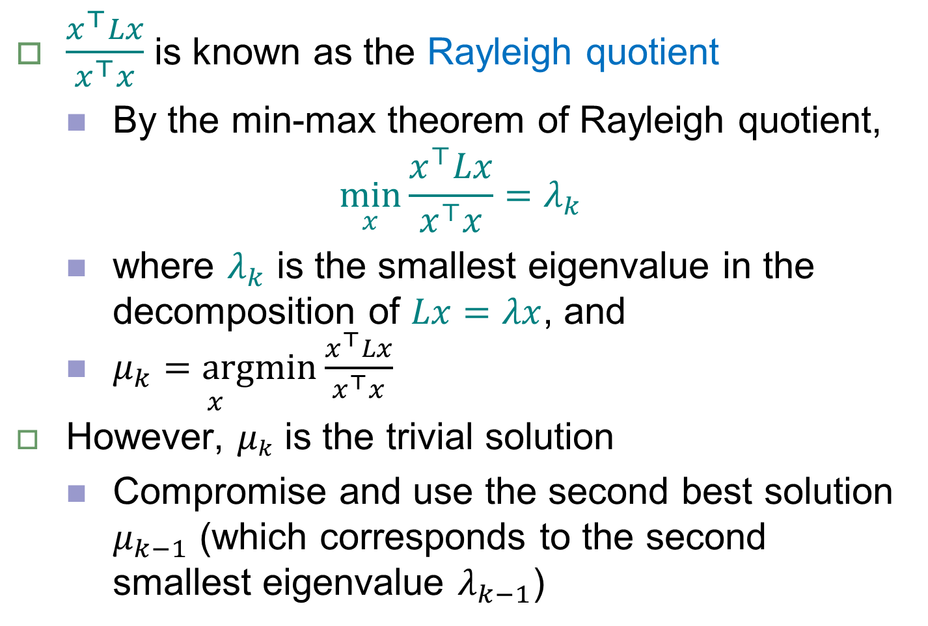
Rayleigh Quotient
$\frac{x^{⊤}Lx}{x^{⊤}x}$ is known as the Rayleigh quotient
By the min-max theorem of Rayleigh quotient,
$$\min_{x}{\frac{x^{⊤}Lx}{x^{⊤}x}}=λ_{k}$$
where $λ_{k}$ is the smallest eigenvalue in the decomposition of $Lx=λx$, and
$\underset{x}{μ_{k}=argmin}{\frac{x^{⊤}Lx}{x^{⊤}x}}$
However, $μ_{k}$ is the trivial solution
Compromise and use the second best solution $μ_{k−1}$ (which corresponds to the second smallest eigenvalue $λ_{k−1}$)

Slide 22
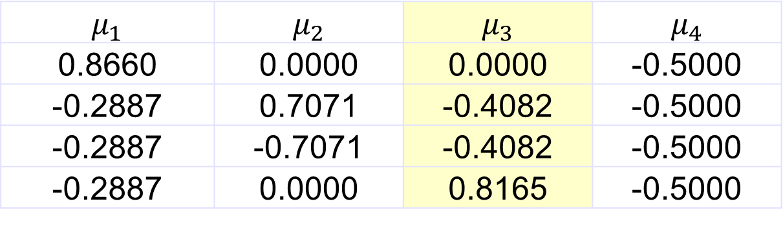

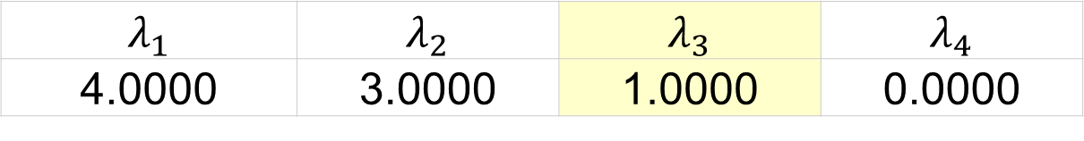
Eigendecomposition example
Eigenvalues
Eigenvectors
$λ_{3}=1=$ optimal value for $\frac{1}{2}\sum_{1≤i,j≤m}{{a_{ij}\left(x_{i}−x_{j}\right)}^{2}}$
If group by the ($±$) sign, $μ_{3}$ correctly places A, B, C in one group ($−$) and D in another ($+$)
$$λ_{1}$$ | $$λ_{2}$$ | $$λ_{3}$$ | $$λ_{4}$$
4.0000 | 3.0000 | 1.0000 | 0.0000
More precisely, -9.51E-17
$$μ_{1}$$ | $$μ_{2}$$ | $$μ_{3}$$ | $$μ_{4}$$
0.8660 | 0.0000 | 0.0000 | -0.5000
-0.2887 | 0.7071 | -0.4082 | -0.5000
-0.2887 | -0.7071 | -0.4082 | -0.5000
-0.2887 | 0.0000 | 0.8165 | -0.5000

Slide 23
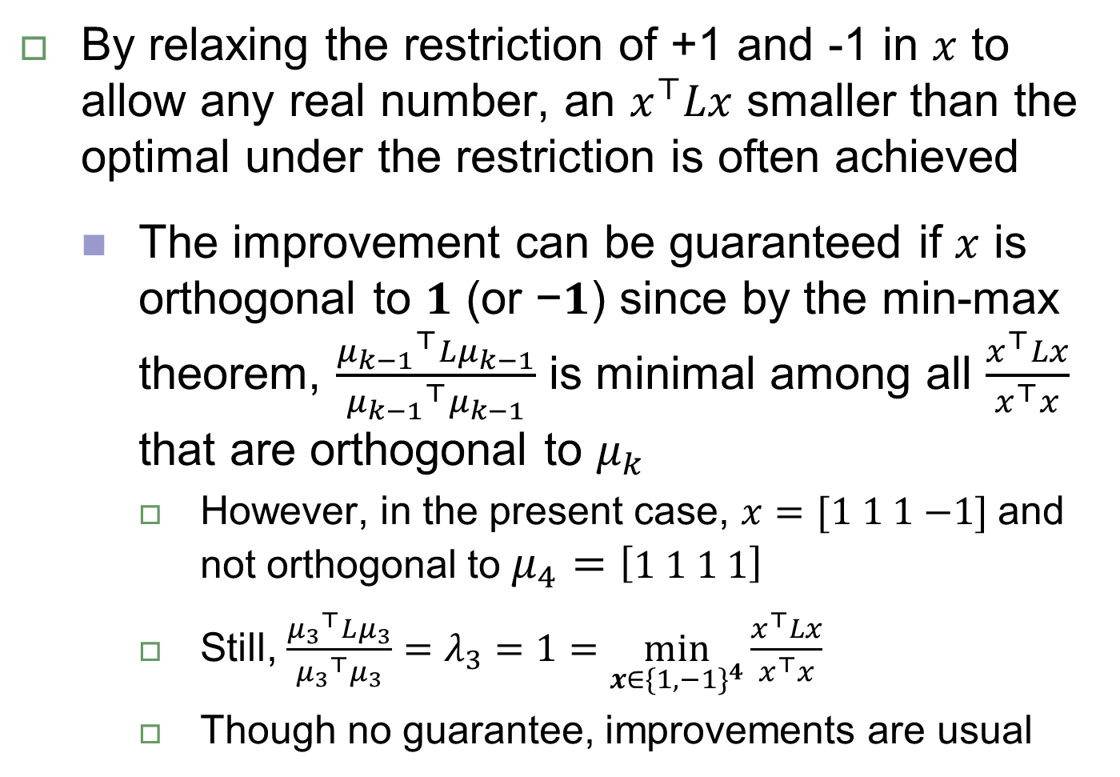
Compromise in +1/-1 restriction
By relaxing the restriction of +1 and -1 in $x$ to allow any real number, an $x^{⊤}Lx$ smaller than the optimal under the restriction is often achieved
The improvement can be guaranteed if $x$ is orthogonal to 𝟏 (or −𝟏) since by the min-max theorem, $\frac{{μ_{k−1}}^{⊤}Lμ_{k−1}}{{μ_{k−1}}^{⊤}μ_{k−1}}$ is minimal among all $\frac{x^{⊤}Lx}{x^{⊤}x}$ that are orthogonal to $μ_{k}$
However, in the present case, $x=[1 1 1 \text{−}1]$ and not orthogonal to $μ_{4}=\left[1 1 1 1\right]$
Still, $\frac{{μ_{3}}^{⊤}Lμ_{3}}{{μ_{3}}^{⊤}μ_{3}}=λ_{3}=1=\min_{x∈{\{1,−1\}}^{4}}{\frac{x^{⊤}Lx}{x^{⊤}x}}$
Though no guarantee, improvements are usual

Slide 24
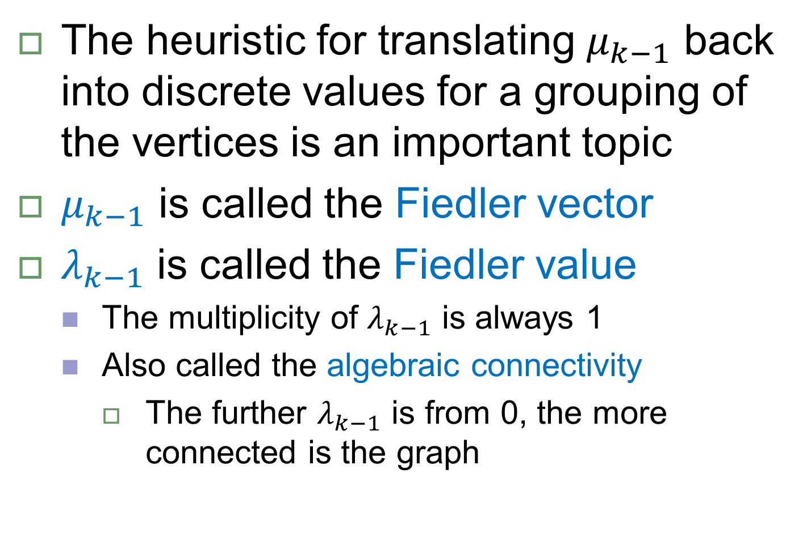

The significance of $μ_{k−1}$ and $λ_{k−1}$
The heuristic for translating $μ_{k−1}$ back into discrete values for a grouping of the vertices is an important topic
$μ_{k−1}$ is called the Fiedler vector
$λ_{k−1}$ is called the Fiedler value
The multiplicity of $λ_{k−1}$ is always 1
Also called the algebraic connectivity
The further $λ_{k−1}$ is from 0, the more connected is the graph

